Slide 1
Chapter : Processes

Slide 2
Chapter : Processes
Process Concept
Process Scheduling
Operations on Processes

Slide 3
Process
A program is a passive entity, such as a file containing a list of instructions stored on disk.
Process is an instance of a program.
A process is an active entity with a program counter specifying the next instruction to execute and a set of associated resources.

Slide 4
Process
Process – a program in execution
Process execution must progress in sequential manner
A process includes:
  program counter
  stack
  data section

Slide 5
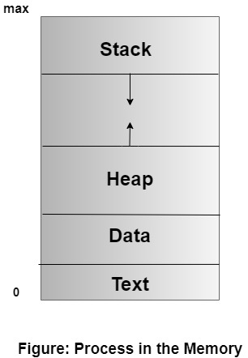
Process
Process memory is divided into four sections for efficient working :
The Text section is made up of the compiled program code
The Data section is made up of the global and static variables
The Heap is used for the dynamic memory allocation
The Stack is used for local variables.

Slide 6
Process States
As a process executes, it changes state
  new: The process is being created
  ready: The process is waiting to be assigned to a processor and is ready to get executed
  running: Instructions are being executed
  waiting: The process is waiting for some event to occur/ waiting for resources
  terminated: The process has finished execution

Slide 7

Process States

Slide 8
Process Control Block (PCB)
Process Control Block (PCB, also called Task Controlling Block) is a data structure in the operating system kernel containing the information needed to manage a particular process.
The PCB is "the manifestation of a process in an operating system".

Slide 9
Process Control Block (PCB)
Information associated with each process:
1. Process State- new, ready….etc.
2. Pointer- to the parent process
3. Program Counter- next instruction to be executed.
4. Process Number- Unique identification number in OS
5. CPU Registers- Various CPU registers where process need to be stored for execution for running state.
6. CPU Scheduling Information- Process Priority and other info. required for scheduling

Slide 10
Process Control Block (PCB)
7. Memory-Management Information- Registers, Page tables (where process is saved)used by OS
8. Accounting Information- For how long CPU and other resources are allocated to process
9. I/O Status Information- List of devices allocated to the process

Slide 11
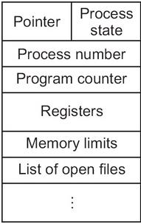
Process Control Block (PCB)

Slide 12
Process Scheduling

Slide 13
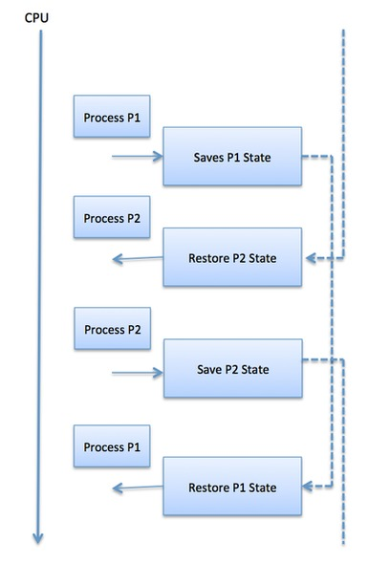
Context Switch
When CPU switches to another process, the system must save the state of the old process in the stack and load the saved state for the new process or reload the state of current process from stack.

Slide 14
Context Switch
Switching the CPU to another process requires saving the state of the old process and loading the saved state for the new process. This task is known as a context switch.
The context of a process is represented in the Process Control Block(PCB) of a process;
it includes the value of the CPU registers, the process state and memory-management information.
When a context switch occurs, the Kernel saves the context of the old process in its PCB and loads the saved context of the new process scheduled to run.

Slide 15
Context Switch
Context switch time is pure overhead, because the system does no useful work while switching.
Its speed varies from machine to machine, depending on the memory speed, the number of registers that must be copied
Typical speeds range from 1 to 1000 microseconds.
Context switching is expensive:
  Direct Cost: No. of cycles for load and store instructions
  Indirect Cost: When process run a lot of its data is stored on processor cache.
Must limit the frequency of context switching.

Slide 16

CPU Switch From Process to Process

Slide 17
Process Scheduling
The activity of determining which process in the ready state should be moved to the running state is known as Process Scheduling.
The prime aim of the process scheduling system is:
  To keep the CPU busy all the time and to deliver minimum response time for all programs.
  For achieving this, the scheduler must apply appropriate rules for swapping processes.

Slide 18
Process Scheduling
Schedulers fall into one of the two general categories:
Non pre-emptive scheduling: When the currently executing process gives up the CPU voluntarily.
Pre-emptive scheduling: When the operating system decides to favor another process, pre-empting the currently executing process.

Slide 19
Process Scheduling
The process scheduling is the activity of the process manager that handles the removal of the running process from the CPU and the selection of another process on the basis of a particular strategy.

Slide 20
Scheduling Queues
The OS maintains all PCBs in Process Scheduling Queues.
The OS maintains a separate queue for each of the process states and PCBs of all processes in the same execution state are placed in the same queue.
When the state of a process is changed, its PCB is unlinked from its current queue and moved to its new state queue.

Slide 21
Process Scheduling Queues
Job queue − This queue keeps all the processes in the system.
Ready queue − This queue keeps a set of all processes residing in main memory, ready and waiting to execute.
  A new process is always put in this queue.
Device queues − The processes which are blocked due to unavailability of an I/O device constitute this queue.

Slide 22
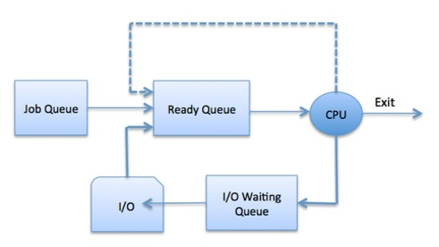
Process Scheduling Queues

Slide 23

Ready Queue And Various I/O Device Queues
Ready Queue is implemented using Linked List

Slide 24

Representation of Process Scheduling
Queuing Diagram

Slide 25
Schedulers
Schedulers are special system software which handle process scheduling in various ways.
Their main task is to select the jobs to be submitted into the system and to decide which process to run.
Schedulers are of three types −
Long-Term Scheduler
Short-Term Scheduler
Medium-Term Scheduler

Slide 26
Long Term Scheduler / Job Scheduler
It determines which processes are admitted to the system for processing.
Selects processes from pool (disk) and bring them into the ready queue
It selects processes from the queue and loads them into memory for execution.
When a process changes the state from new to ready, then there is use of long-term scheduler.
It controls Degree of Multiprogramming (DoM)
DoM: The degree of multiprogramming describes the maximum number of processes that a single-processor system can accommodate efficiently.

Slide 27
Long Term Scheduler / Job Scheduler
The primary objective of the job scheduler is to provide a balanced mix of jobs, such as I/O bound and processor (CPU) bound.
  I/O BOUND: that spends its more time in doing I/O than computations.
  CPU BOUND: that spends its more time doing computations.
  LTS selects a good process.
Good Process: (I/O Bound + CPU Bound)

Slide 28
Process States

Slide 29
Short-Term Scheduler (CPU Scheduler)
Short-term schedulers, also known as dispatchers.
Selects which process should be executed next among the processes and allocates CPU to one of them.
(From Ready Queue Selects one process for execution and Allocate CPU (Running Queue))
It must select process for CPU execution frequently.
Short-term schedulers are faster than long-term schedulers.

Slide 30
Medium Term Scheduling
Medium-term scheduling is a part of swapping.
Reduces DOM(Degree of Multiprogramming)
Processes are created and stored in Main Memory by Long Term Scheduler, But these processes has to wait for their turn to get execute.
In Main Memory only those processes are kept that require execution.
When ready queue is empty,
MTS Swap-In and Swap-Out the processes from Main Memory and Secondary Memory.
Ready + Running + Waiting Queues are in Main Memory

Slide 31
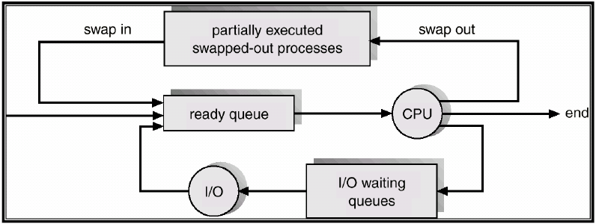
Medium Term Scheduling

Slide 32
Process Operations

Slide 33
Operations on Process
1. Process Creation
2. Process Termination

Slide 34
Process Creation
Parent process create children processes, which, in turn create other processes, forming a tree of processes
The process which creates other process, is termed the parent of the other process, while the created sub-process is termed its child.
Each process is given an integer identifier, termed as process identifier, or PID. The parent PID (PPID) is also stored for each process.

Slide 35
Process Creation (Cont.)
Resource sharing
  Parent and children share all resources
  Children share subset of parent’s resources
  Parent and child share no resources
Execution Sequence
  Parent and children execute concurrently
  Parent waits until children terminate

Slide 36
Process Creation (Cont.)
Address Space
Address space may refer to a range of either physical or virtual addresses accessible to a processor or reserved for a process.
  Child process is duplicate of parent process (same program and data
  Child process has new program loaded into it
Each process is identified by its process identifier
UNIX examples
  fork () system call creates new process
  exec() system call used after a fork to replace the process’ memory space with a new program

Slide 37
fork()
System call fork() is used to create processes.
It takes no arguments and returns a process ID.
The purpose of fork() is to create a new process, which becomes the child process of the caller.
After a new child process is created, both processes will execute the next instruction following the fork() system call.

Slide 38
This can be done by testing the returned value of fork():
If fork() returns a negative value, the creation of a child process was unsuccessful.
fork() returns a zero to the newly created child process.
fork() returns a positive value, the process ID of the child process, to the parent.

Slide 39


Slide 40
Process Creation
There are two options for the parent process after creating the child :
1. Wait for the child process to terminate before proceeding.
  Parent process makes a wait() system call, for either a specific child process or for any particular child process, which causes the parent process to block until the wait() returns.
2. Run concurrently with the child, continuing to process without waiting.
There are also two possibilities in terms of the address space of the new process:
The child process is a duplicate of the parent process.
The child process has a program loaded into it.

Slide 41
Process Termination
Process executes last statement and asks the operating system to terminate it (by using exit() system call)
  Process’ resources are de-allocated by operating system
Parent may terminate execution of children processes (abort)
Why?
  Child has exceeded allocated resources
  Task assigned to child is no longer required
  If parent is exiting/Terminated
    Some operating system do not allow child to continue if its parent terminates
      All children terminated - cascading termination

Slide 42
Process Termination
Processes may also be terminated by the system for a variety of reasons,
  The inability of the system to deliver the necessary system resources.
  In response to a KILL command or other unhandled process interrupts.
  A parent may kill its children if the task assigned to them is no longer needed.
  If the parent does not exit, the system may or may not allow the child to continue without a parent (orphaned processes are generally inherited by init, which then proceeds to kill them.)

Slide 43
Process Termination
When a process ends, all of its system resources are freed up. The process termination status and execution times are returned to the parent if the parent is waiting for the child to terminate,
or eventually returned to init if the process already became an orphan.
The processes which are trying to terminate but cannot do so because their parent is not waiting for them are termed zombies. These are eventually inherited by init process as orphans and killed off.

